Slide 1
CHANDIDAS MAHAVIDYALAYA
DEPARTMEANT OF GEOGRAPHY
Topic.- SOIL OF INDIA
Prof.- Indrajit Mandal

Slide 2
TOPIC :- SOIL OF INDIA
Definition of Soil
Soil can be simply defined as a mixture of small rock particles/debris and organic materials/ humus which develop on the earth surface and support growth of plants.

Slide 3
Soil Classification – Urvara vs Usara
In India, soil had been classified from the ancient period itself even though it was not as detail as the modern classifications.
In the ancient period, the classification was based on only two things; whether the soil is fertile or sterile. Thus the classification were:
Urvara [fertile]
Usara [sterile

Slide 4
Soil Classification – Agencies involved
In the modern period, when men started to know about the various characteristics of soil they began to classify soil on the basis of texture, colour, moisture etc.
When the Soil survey of India was established in 1956, they studied soils of India and their characteristics.
The National Bureau of Soil Survey and the Land Use Planning, an institute under the control of Indian Council of Agriculture Research did a lot of studies on Indian soil.

Slide 5
Major classification of Indian soils
Alluvial soil [43%]
Red soil [18.5%]
Black / regur soil [15%]
Arid / desert soil
Laterite soil
Saline soil
Peaty / marshy soil
Forest soil
Sub-mountain soil
Snowfields

Slide 6
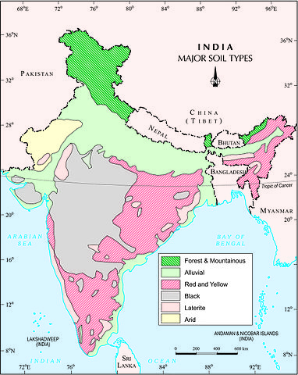

Slide 7
1. Alluvial soil:
Mostly available soil in India (about 43%) which covers an area of 143 sq.km.
Widespread in northern plains and river valleys.
In peninsular-India, they are mostly found in deltas and estuaries.
Humus, lime and organic matters are present.
Highly fertile.
Indus-Ganga-Brahmaputhra plain, Narmada-Tapi plain etc. are examples.
They are depositional soil – transported and deposited by rivers, streams etc.
Sand content decreases from west to east of the country.
New alluvium is termed as Khadar and old alluvium is termed as Bhangar.

Slide 8
Colour: Light Grey to Ash Grey.
Texture: Sandy to silty loam or clay.
Rich in: potash
Poor in: phosphorous.
Wheat, rice, maize, sugarcane, pulses, oilseed etc are cultivated mainly.

Slide 9
2. Red soil:
Seen mainly in low rainfall area.
Red Soil in India are poor in phosphorus, nitrogen and lime contents. The red soils covers a large portion of land in India. It is found in Indian states such as Tamil Nadu, southern Karnataka, north-eastern Andhra Pradesh and some parts of Madhya Pradesh, Chhattisgarh and Odisha.
Wheat, cotton, pulses, tobacco, oilseeds, potato etc are cultivated.

Slide 10
3. Black soil / regur soil:
Regur means cotton – best soil for cotton cultivation.
Most of the Deccan is occupied by Black soil.
High water retaining capacity.
Rich in: Iron, lime, calcium, potassium, aluminum and magnesium.
Colour: Deep black to light black.
It is mostly found in areas such as Gujarat, Madhya Pradesh andMaharashtra. It is also found in states like Tamil Nadu, Andhra Pradesh and Karnataka. Black soil is extremely fine and clayey and has the capacity to hold a lot of moisture.

Slide 11
4. Laterite soil:
Rich in: Iron and Aluminum
Deficient in: Nitrogen, Potash, Potassium, Lime, Humus
Colour: Red colour due to iron oxide.
Rice, Ragi, Sugarcane and Cashew nuts are cultivated mainly.
These soils have mainly developed in the higher areas of the Peninsular plateau. The laterite soils are commonly found in Karnataka, Kerala, Tamilnadu, Madhya Pradesh and the hilly areas of Orissa and Assam. Soil Colour: Reddish brown in colour due to the presence of iron oxide.

Slide 12
5. Saline soil:
Saline soil are found in the coastal area of the any country .
Crops tolerant include cotton, alfalfa, cereals, grain sorghum, sugar beets, Bermuda grass, tall wheat grass and Harding grass. Salinity higher than desirable for greenhouse soils. Strongly saline.

Slide 13
6. Desert / arid soil:
In general, Desert soil is found in arid and semi arid areas with low rainfall.Such places are Rajasthan ,some parts of Gujarat,Haryana and Punjab.
Deposited mainly by wind activities.
High salt content.
Lack of moisture and Humus.
Kankar or Impure Calcium carbonate content is high which restricts the infiltration of water.
Nitrogen is insufficient and Phosphate is normal.
Texture: Sandy
Colour: Red to Brown.

Slide 14
7. Peaty / marshy soil:
Areas of heavy rainfall and high humidity.
Growth of vegetation is very less.
A large quantity of dead organic matter/humus which makes the soil alkaline.
Heavy soil with black colour.
This type soil are found in Kerala.

Slide 15
8. Forest soil:
Regions of high rainfall.
Humus content is less and thus the soil is acidic.
It is the most important type of soil found in the country as it covers about 40% of the total land. It is found in the northern plains beginning from Punjab to West Bengal and Assam. It is also found in deltas of different rivers such as Krishna, Godavari, Kaveri and Mahanadi in peninsular India.

Slide 16
9. Mountain soil:
In the mountain regions of the country.
Immature soil with low humus and acidic.
Mountain soil are mainly found on the hill slopes.These soils are formed due to mechanical withering caused by snow,rain,temperature variation,etc. These mountain soils are found in hilly regions of Jammu and Kashmir,Sikkim, Assamand Arunachal pradesh.These soils occupy about 8% of the total land area of India.

Slide 17
10. Snowfields
This type of soil are found in the polar and mountain area. Like Himalaya Region.

Slide 18
THANK YOU

